Slide 1


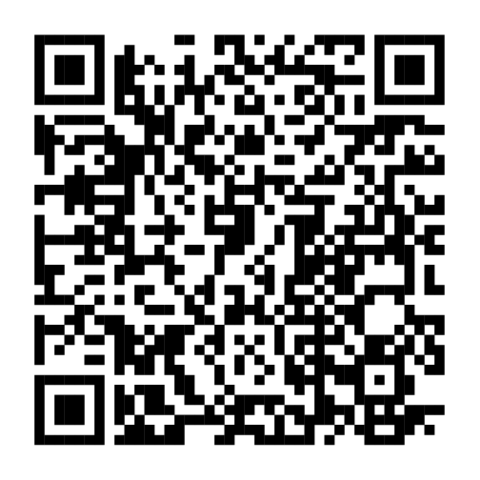
Don’t forget to open your Fidelity HSA®.
If you enrolled in the [HSA-eligible health plan
NAME], you can open an HSA to take advantage of its benefits.
Scan this code or visit NetBenefits.com
to quickly open your Fidelity HSA.
Fidelity Brokerage Services LLC, Member NYSE, SIPC, 900 Salem Street, Smithfield, RI 02917
© 2024 FMR LLC. All rights reserved.
1127254.1.0
CLIENT LOGO

